Slide 1
Sermon Series: The Prophet Isaiah
April 30, 2017
“The Call for Godly Leadership”
First Baptist Church of Poolville

Slide 2
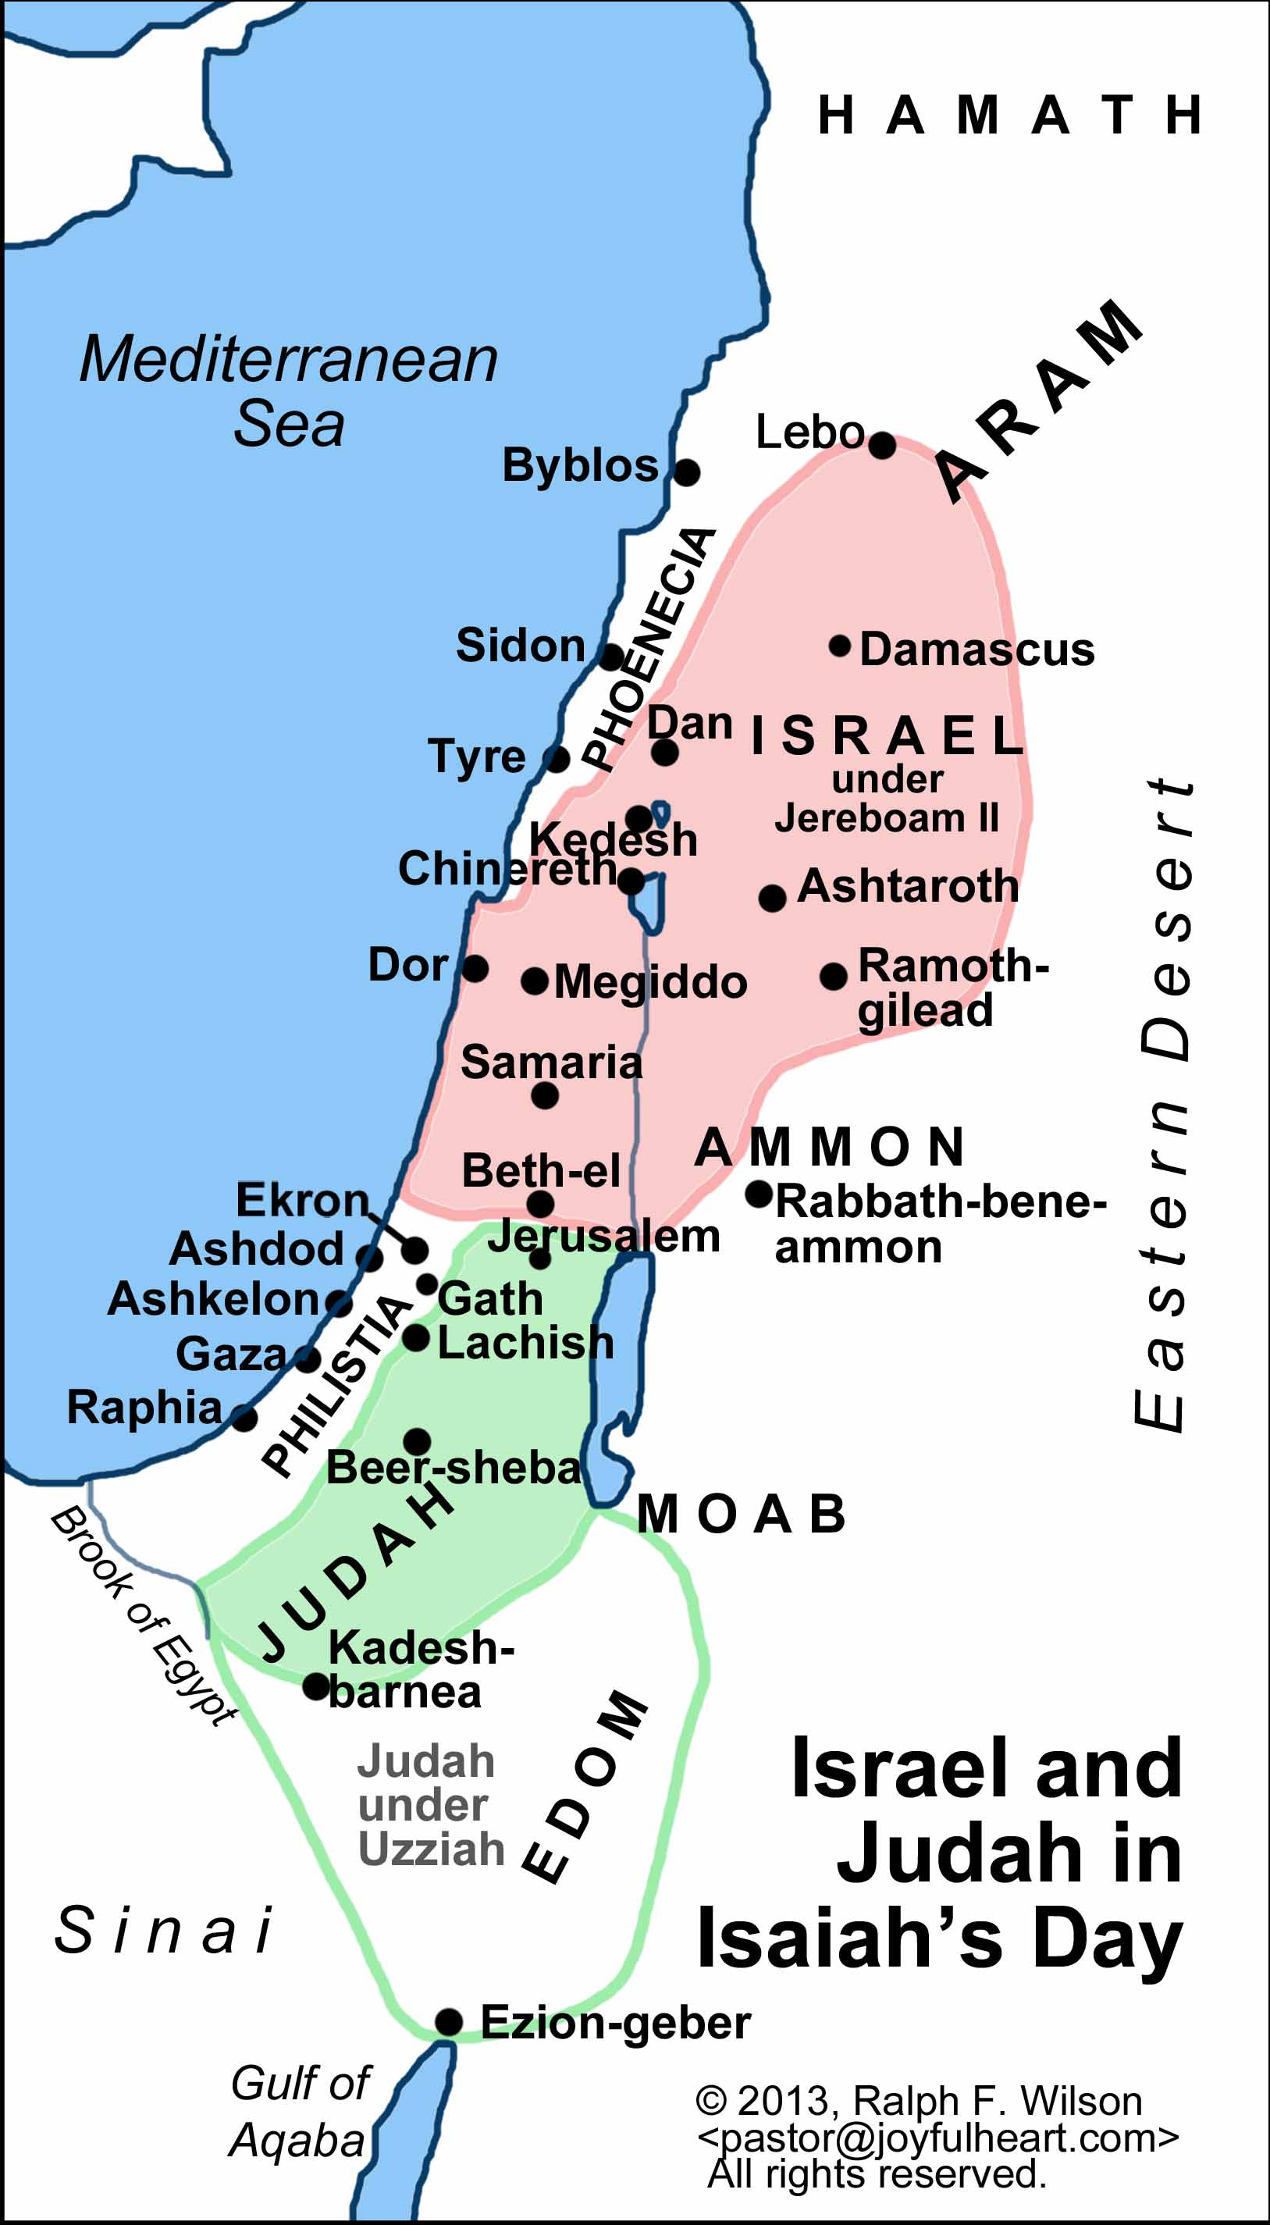

Slide 3
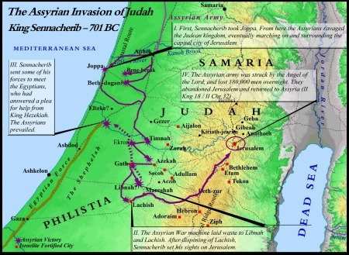

Slide 4
